Slide 1
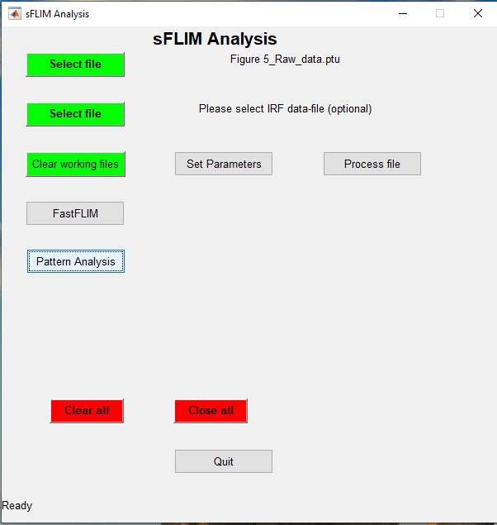
Step 1: Launch Spectral-FLIM GUI
Type sFLIM in MATLAB command line window
Step 1
Step 2
Step 2: Select a .ptu file for processing
From Raw data folder choose file
“Figure 5_Raw_data.ptu”
Step 3
Step 3: Launch sFLIM pattern-matching based data analysis
Push button – Pattern Analysis

Slide 2
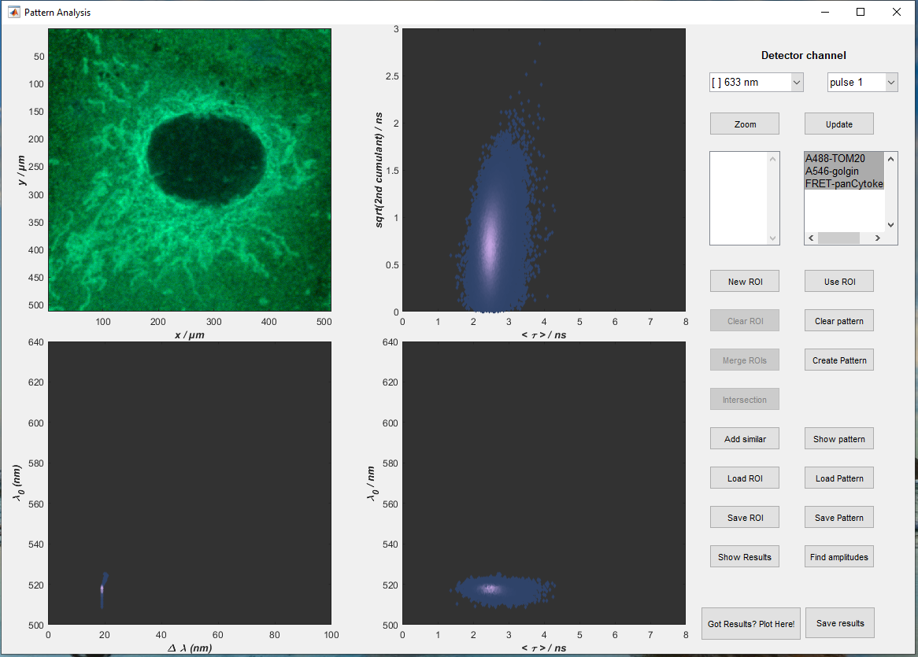
Step 4: Load reference patterns
Load reference patterns from folder - Figure 5 Reference Patterns and Results
Select patterns one-by-one
A488-TOM20
A546-golgin
FRET-panCytokeratin
Step 5: Launch Pattern-matching analysis*
Push button – Find amplitudes
Step 4:
Step 5:
*Results for Figure 5 are already available and can be visualized directly – goto step 9

Slide 3
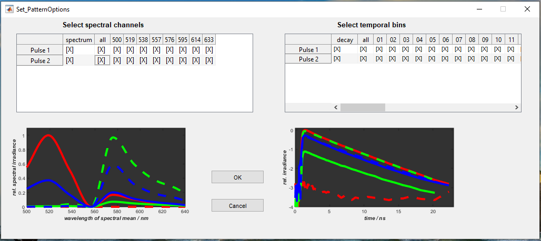
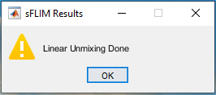
Step 5: Select all information channels
Click twice (not a double click) on the red marked buttons in Set_PatternOptions gui
Step 5:
Step 5:
Step 6: Wait for analysis to be finished
Once the unmixing is done, sFLIM Results message will pop up.
Press ok and proceed to results visualization
Step 6:

Slide 4
Step 8: Make composite image
After unmixing we get three unmixed image corresponding to 3 reference patterns
Press Show Results button to generate a composite image
Step 9: Results for Figure 5 are already available and can be visualized directly
After unmixing we get three unmixed image corresponding to 3 reference patterns
Press Show Results button to generate a composite image
Select file Figure 5_Raw_data_results.mat
Step 8:
Step 9:

